Slide 1
Project Title
DEVELOPMENT OF A WEB APP FOR DIRECTORY OF SCHOOLS IN NIGERIA

Slide 2
Education
3
Background
Record keeping/Documentation
Access to detailed data about schools accross Nigeria
Informed decisions for stakeholders: diasporans, policy-makers, etc

Slide 3
Objectives
To create a user friendly interface for accessing Nigerian school’s database
To develop a robust backend for storing, updating and managing school information securely
To implement search and filtering functionalities to find specific schools
Conduct user testing and gather feedback for necessary improvement during development process
Deploy the web app on a reliable hosting platform and ensure ongoing maintenance and support

Slide 4
Technological Stacks
HTML, CSS
Javascripts
Node.js/React
AI (to be incorporated at a later time)

Slide 5


Slide 6
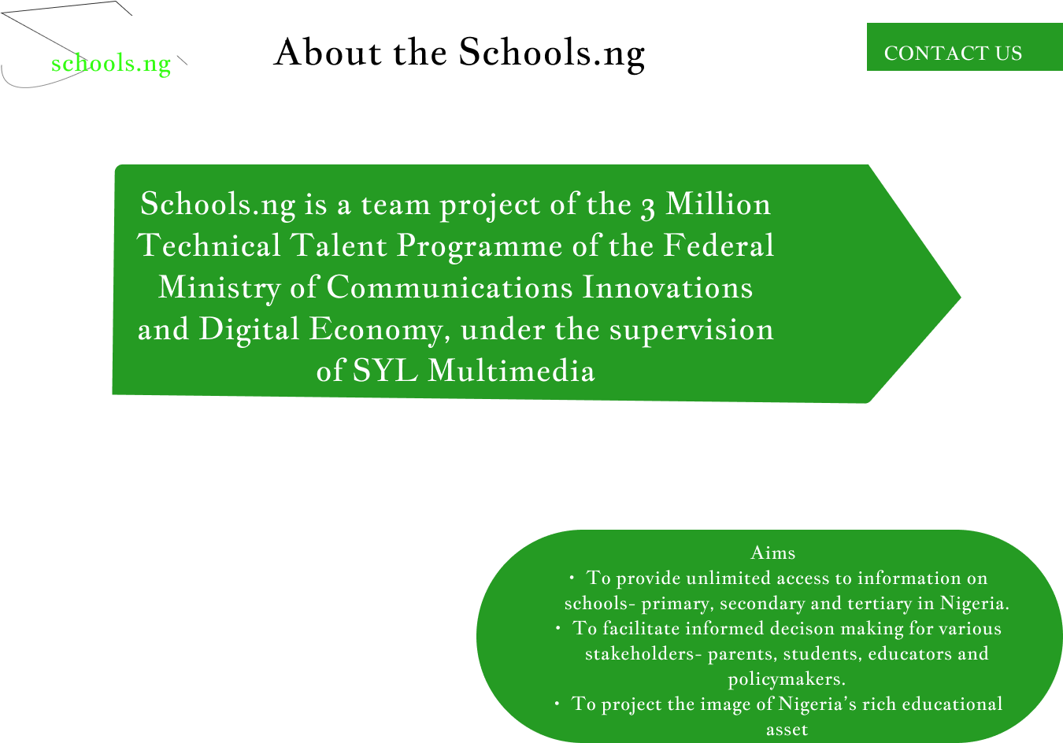

Slide 7
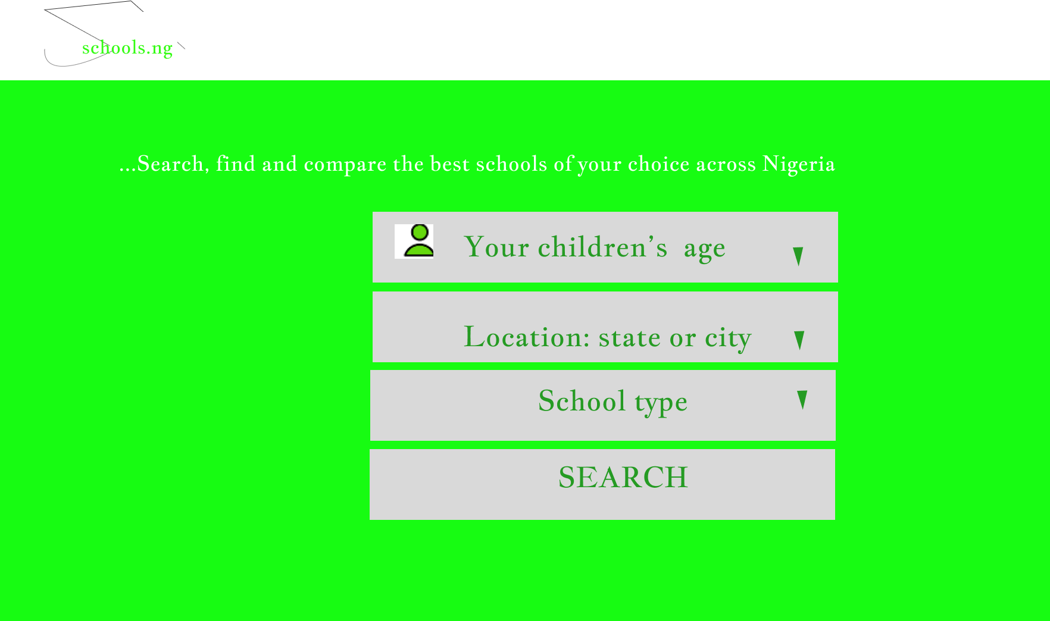

Slide 8
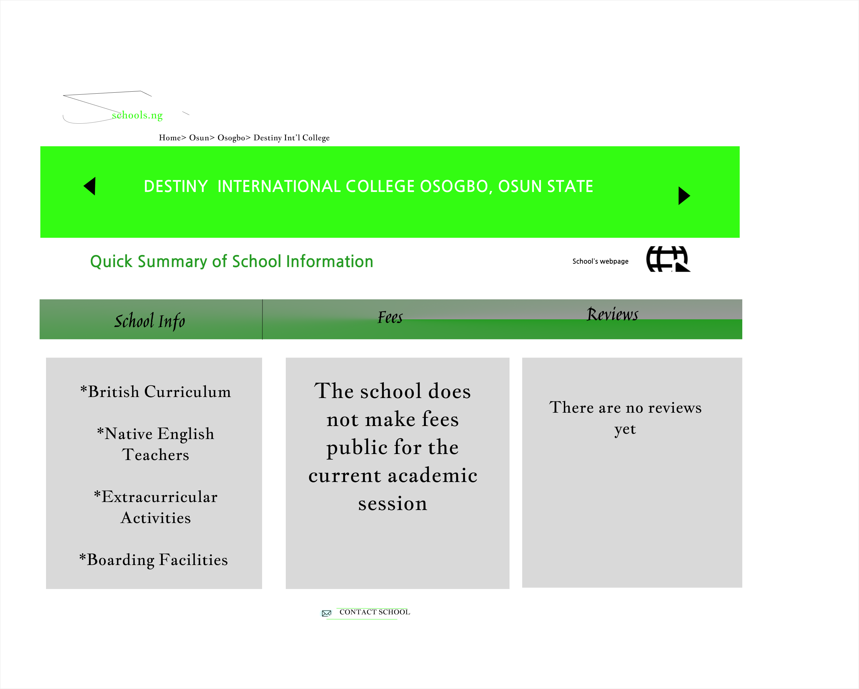

Slide 9
Thank You
18

